Slide 1
Notes:
RETAILERS
WHOLESALERS
HAULIERS
EQUINE
PROPERTY OWNERS
ENGINEERS
MANUFACUTURERS
MOTOR TRADERS
PUBS/RESTAURANTS
CHURCHES AND CHARITIES
CONSTRUCTION
MOTOR FLEET
DISTILLERIES
MEDICAL PROFESSIONALS
SOLE TRADERS
CONSULTANTS AND PROFESSIONALS
AND MANY MORE.
IF YOU ARE A BUSINESS, WE CAN TALK TO YOU

Slide 2
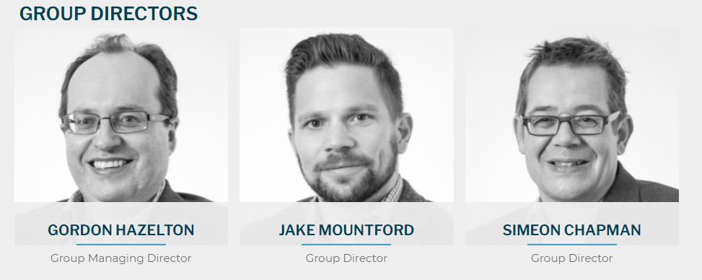
WHO ARE WE?
EST. 2008
Notes:
Hazelton Mountford is now in it’s 13th year.
The firm was created by Gordon Hazelton in 2008, who could see that many of the local brokers, such as Clark Roxburgh, were being lost or taken over by blue chip companies such as Jelf. Gordon has over 30 years experience looking after the insurance and risk management requirements of commercial clients, and has recently graduated from Warwick Business School after achieving his MBA.
Gordon was almost immediately joined by Jake Mountford, in December 2008, followed by Simeon Chapman in January 2011, and between them, they have over 85 years experience in the insurance industry.
The firm now has over 30 staff, and supporting local businesses is something that remains at the heart of what we do.
In recent years, all major insurers are spotting the huge benefit of using brokers, and can often provide preferential rates, or enhanced levels of cover. We have been able to work with many top insurers to decide which markets we feel are best suited to our clients.
The insurers do not charge more when using a broker - instead, a percentage of that premium is paid as commission to the broker. So in other words, the service is charged to the insurer, not the client.
Hazelton Mountford Ltd still remain Worcestershire's only registered Chartered Independent Insurance Broker.

Slide 3
Risks for Charities
Asset protection
Property
Contents
People
Income protection
Loss of income/business interruption
Liabilities

Slide 4
Three key Areas for Focus
Trustees Indemnity (Management Liability/ directors and Officers )
Abuse
Cyber & Data

Slide 5
Trustees Indemnity
Requirements of a Trustee &/or Director
"such precautions as a prudent man of business would take in managing similar affairs of his own”
Doing your best is not good enough

Slide 6
Abuse Cover
Vulnerable Adults
Minors

Slide 7
Cyber & Data risks
Website
Personal Data
Virus/Ransomware
Paper

Slide 8
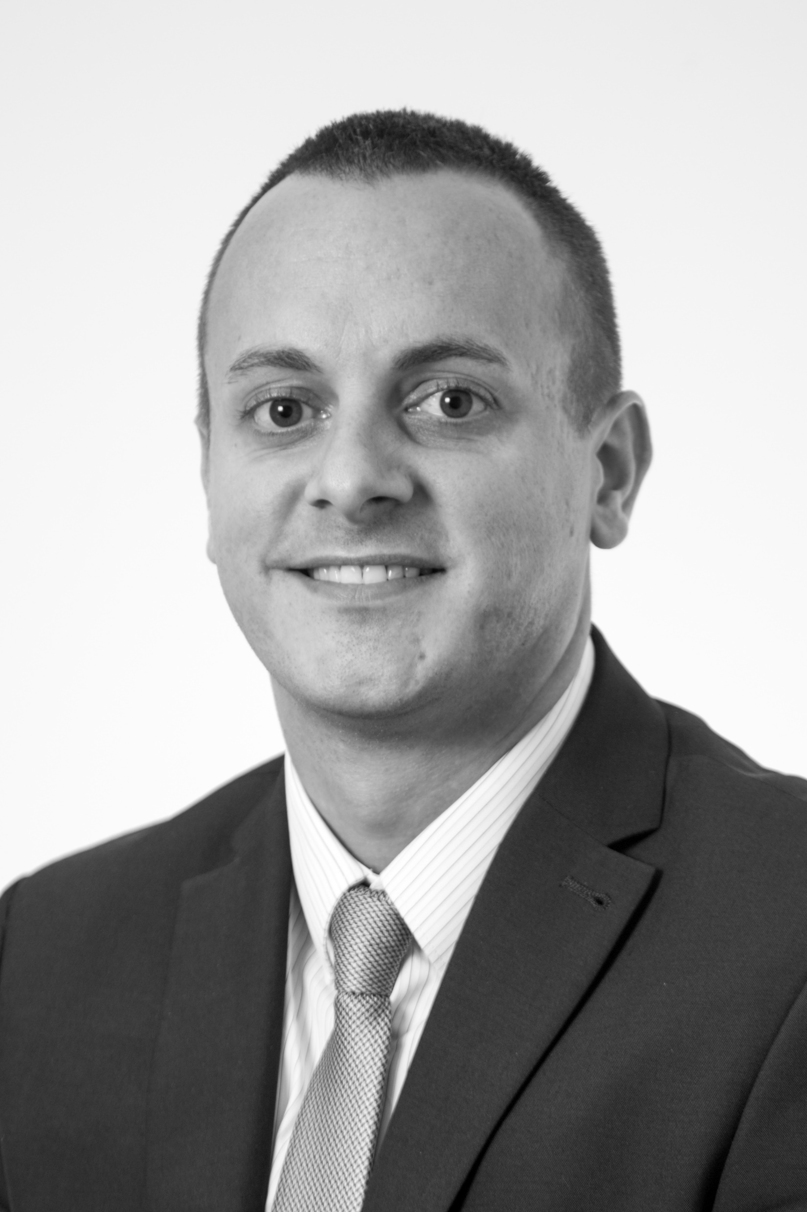
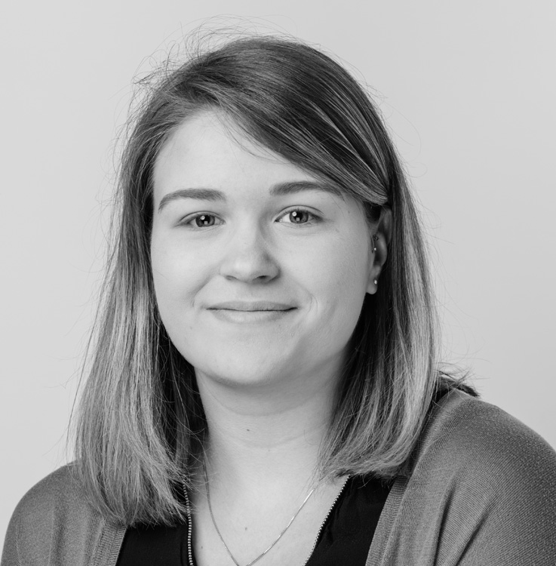
The TEAM
Dan Tustin – Senior Account Handler
Lucy Henderson – Account Handler
Notes:
Jess - I the company in April 2018, started out in Personal Lines insurances, dealing with a wide variety of products and building a solid foundation. In 2016, I then progressed into Commercial Insurance and haven’t looked back since.
Lucy - Lucy joined the company in April 2019 as an Account Handler with 3 years’ experience at both broker and underwriter level dealing with commercial and personal lines insurance
Vee - Veronique joined Hazelton Mountford in 2016, and in 2017 she joined our Commercial Insurance department

Slide 9
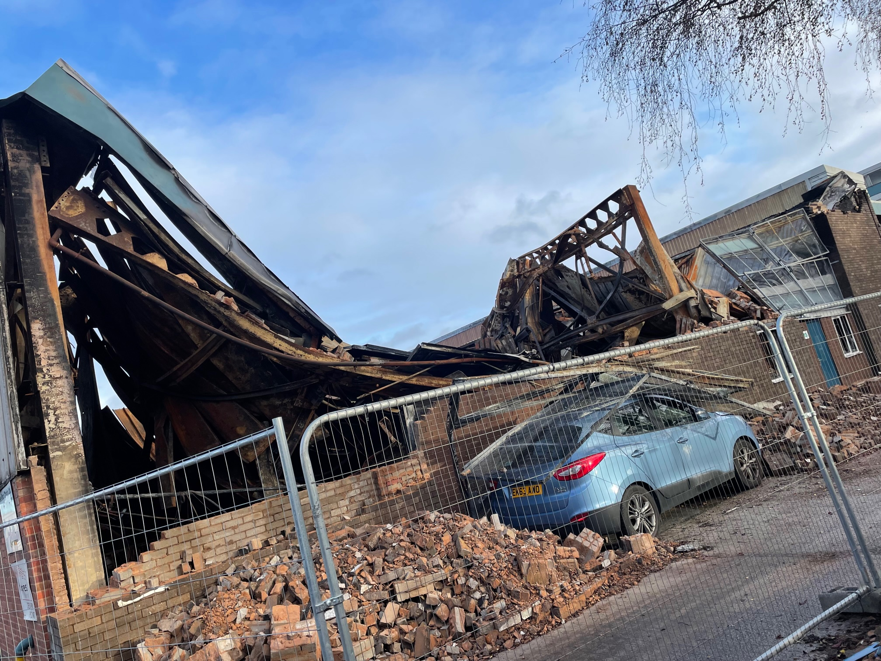
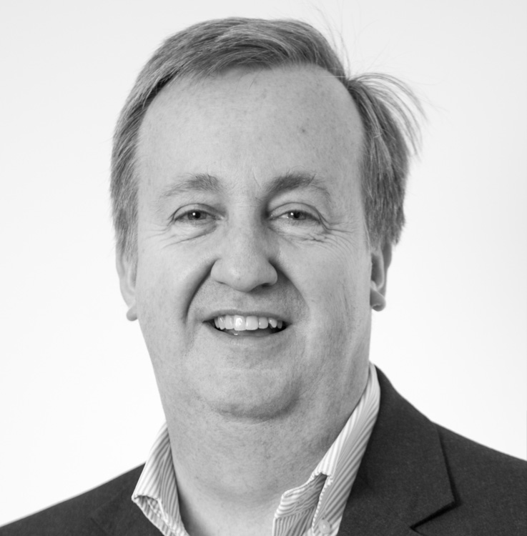
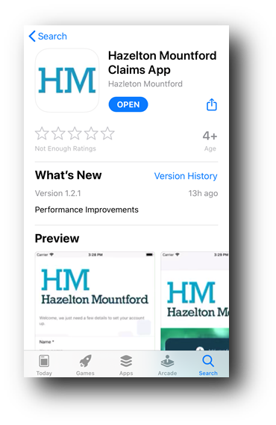
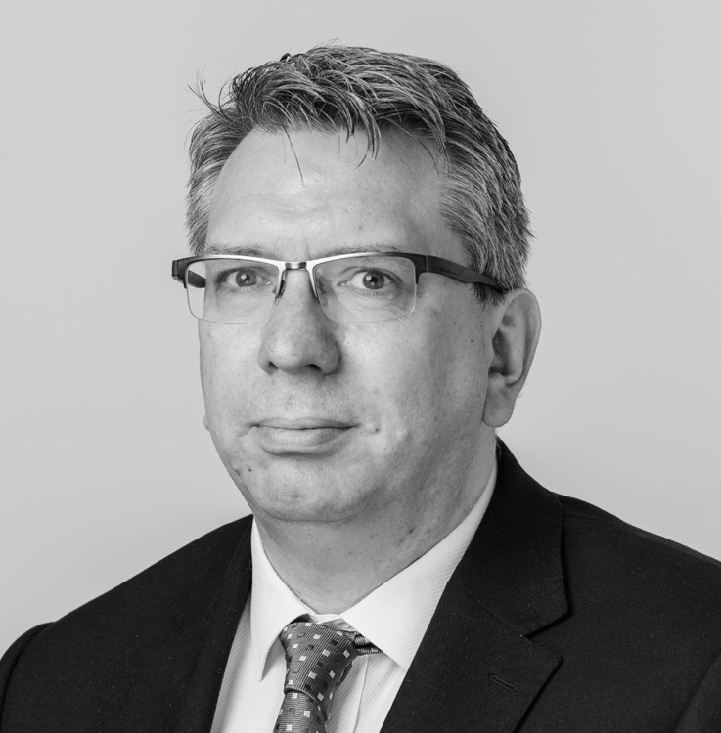
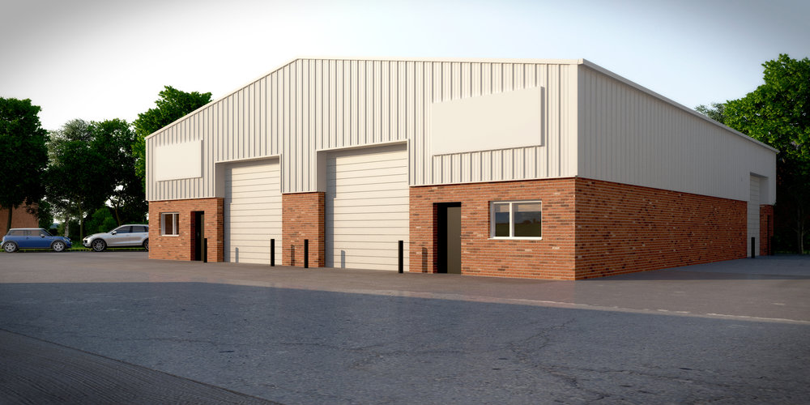
IN HOUSE CLAIMS DEPARTMENT
Notes:
One of our unique selling points, is the fact we utilise our very own in house claims department, in the form of David Webb, our claims manager, and Graham Pearson, our claims handler. Having an inhouse claims department enables us to manage each individual claim for our clients, taking control of communication between the insured and the insurer and other claim related negotiations, such as loss adjustors/loss assessors, third party disputes, and even insurer settlement figures. This take all the pressure off the client having to manage the claim themselves, and enables them to get back to running their business. We handle all claims, from motor claims, to Employers & Public Liability, fire, theft, flood - any product we provide to a client, would be supported by our claims team should the worse happen.
Further still, for motor fleet clients, we offer a free claims app that can be downloaded, and this allows client’s to report road incidents within minutes. Whilst still at the scene of the accident, the HM claims app will prompt you to gather vitally important information including pictures. The more information we have for a claim, the quicker it gets settled and the lower the costs. Via the app, the claims form then gets automatically emailed to our claims department to forward onto your insurers.
David started within the general insurance industry in 2007, with a particular expertise in claim
Graham - Graham started at Hazelton Mountford in April 2019, already having 18 years experience He started his career in Personal Lines Insurance in 2001
David -

Slide 10
THANK YOU
Hazelton Mountford Ltd
01905 721242
07958 352939
simeon@hazeltonmountford.co.uk

